Slide 1
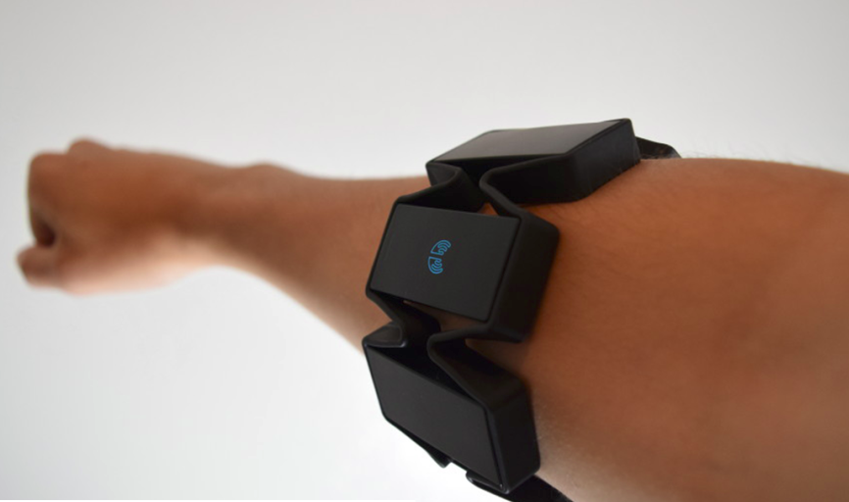
Virtual Numpad using EMG Signals
~ Vinita Narayanamurthi
Rashmi Ballamajalu

Slide 2
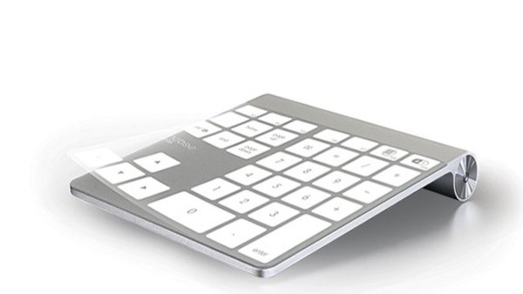
Motivation
EMG signals -> gestures done using fore, middle and ring fingers
Myo armband used to build a virtual number pad
Current implementations using camera, light/shadow sensors, and software keyboards that use mouse click
Use of bio signals induce challenges in generalizing trained model
Advantage -> Myo armband is the only hardware required

Slide 3
Implementation
Raw EMG Signal of Finger Movements using MYO Armband
Feature Extraction
Pre-Processing (Zero Mean & 60 Hz Noise Removal using Butterworth Filter)
Data Acquisition using Lab Stream Layer
Event Marker Random Number generator (0-9)
Classification Using SVM And Decision Tree
Features Extracted
Root Mean Square (RMS) deviation of the signal
Variance
Difference Absolute Standard Deviation (DAS) of wavelength between consecutive samples
Maximum Fractal Length -> for measuring low-level signals
Average Amplitude Change -> contains information about frequency, duration and amplitude of signal

Slide 4
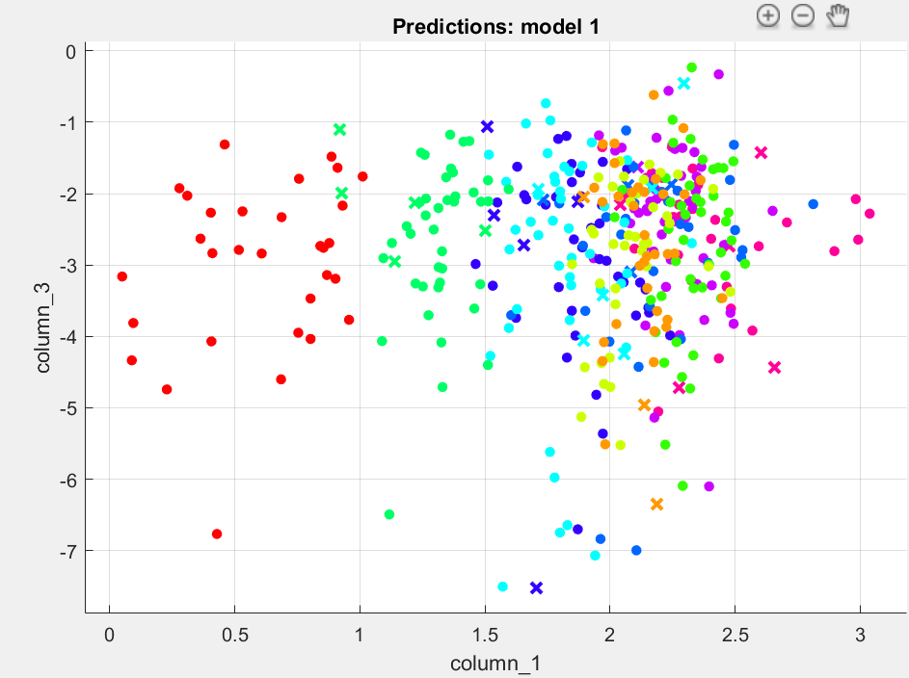
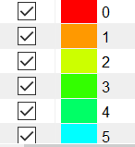
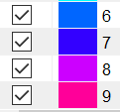
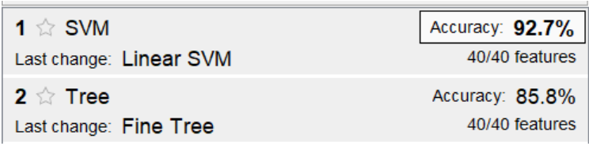
Training Model and Results
Scatter Plot
Bias reduced -> model trained with data points randomized
Data collected over multiple days
Offline Accuracy

Slide 5
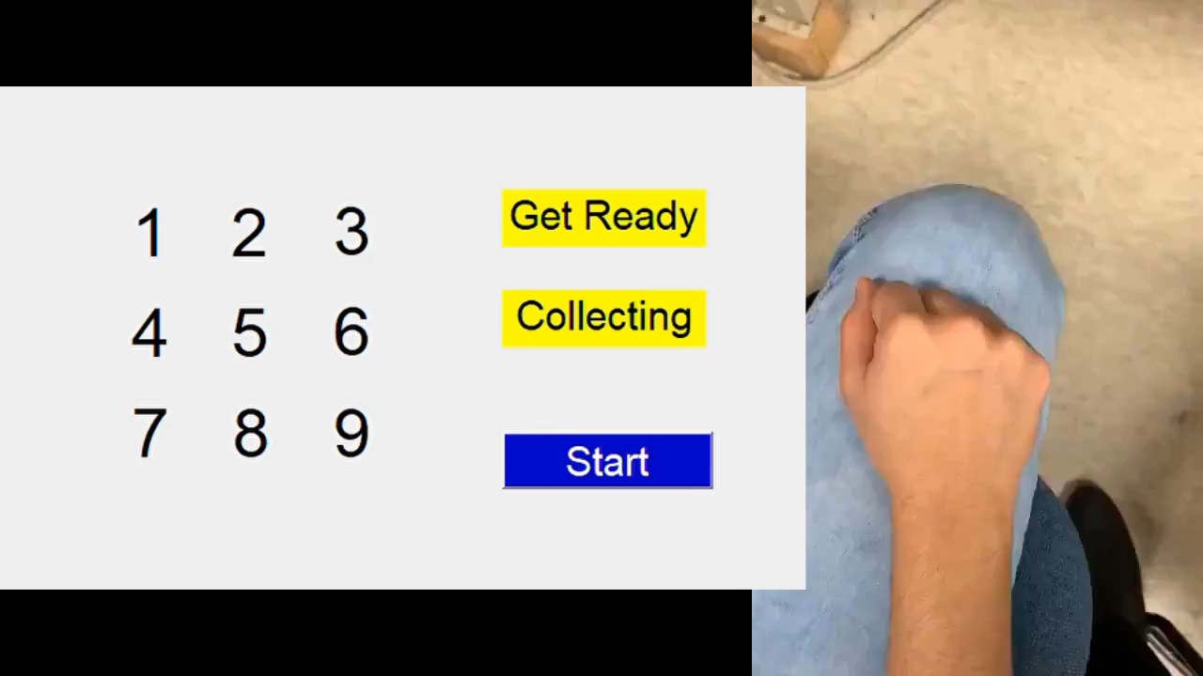
Real Time Implementation
Raw EMG samples collected -> window of 3s (~600)
Data Acquisition using Lab Stream Layer
Feature Extraction
Pre-Processing
Classification Using Trained Model
Show output to user through GUI

Slide 6
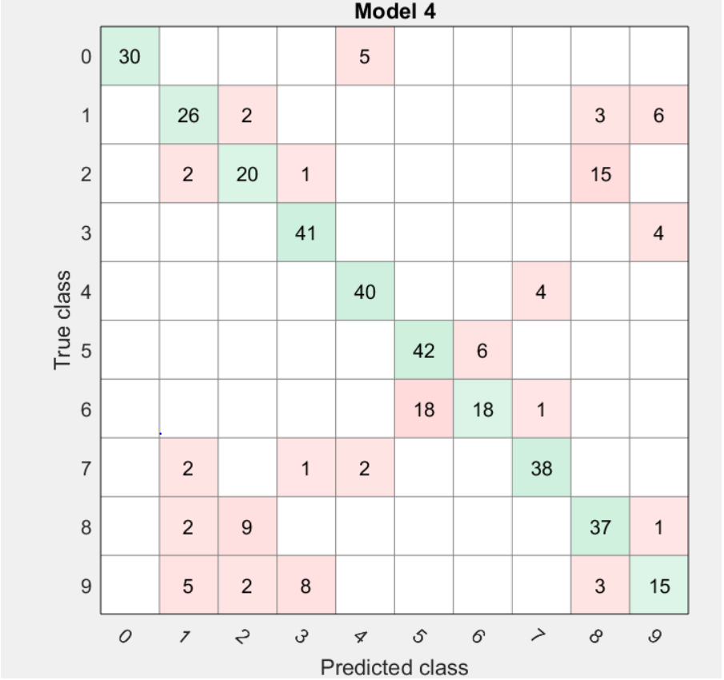
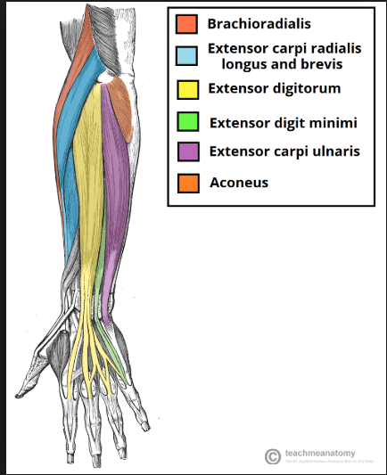
Real Time Misclassification
Confusion Matrix
Arm Muscles

Slide 7
Future Work
Questions
Generalize model to work for all
Improve reliability of model for faster typing speeds
How did we manage to reduce the bias while training the model.
As a customer, would you prefer a wearable sensor or a generic sensor like camera

